Slide 1

第一章. 概率论的基本概念
Weiqi Luo (骆伟祺)
School of Data & Computer Science
Sun Yat-Sen University
Email：luoweiqi@mail.sysu.edu.cn

Slide 2
教程
盛骤、谢式千、潘承毅，《概率论与数理统计》第4版，高等教育出版社，2008
参考书
  Jay L. Devore, Probability and statistics for engineering and the sciences (the 8th Edition), 2010

Slide 3



概率统计常用工具

Slide 4
Prerequisite Courses
SE-101 Advanced Mathematics
SE-103 Linear Algebra
Successive Courses
SE-328 Digital Signal Processing
SE-343 Digital Image Processing
SE-352 Information Security
Pattern Recognition & Machine learning
etc.

Slide 5
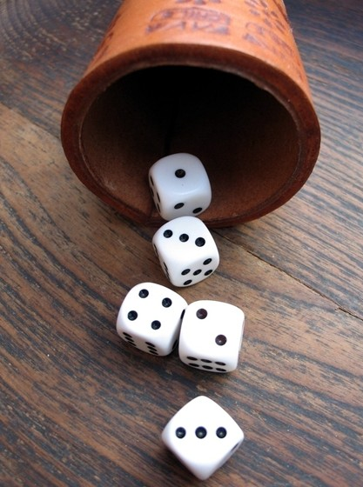
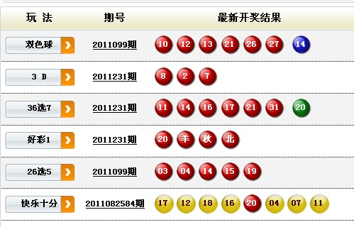
不确定性
Uncertainty
It can be assessed informally using the language such as “it is unlikely” or “probably”.
This science came of gambling in 7th century

Slide 6
Probability Vs. Statistics
Probability measures uncertainty formally, quantitatively. It is the mathematical language of uncertainty.
Statistics show some useful information from the uncertain data, and provide the basis for making decisions or choosing actions.

Slide 7
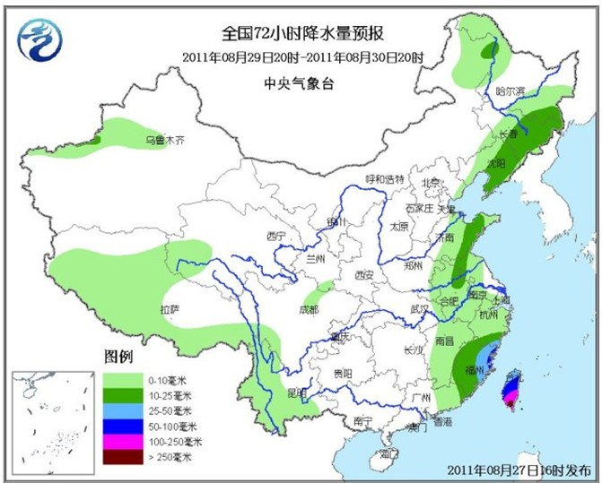
实际应用
天气预报

Slide 8

实际应用
疾病分析
e.g. Relationship between
smoking and lung cancer

Slide 9
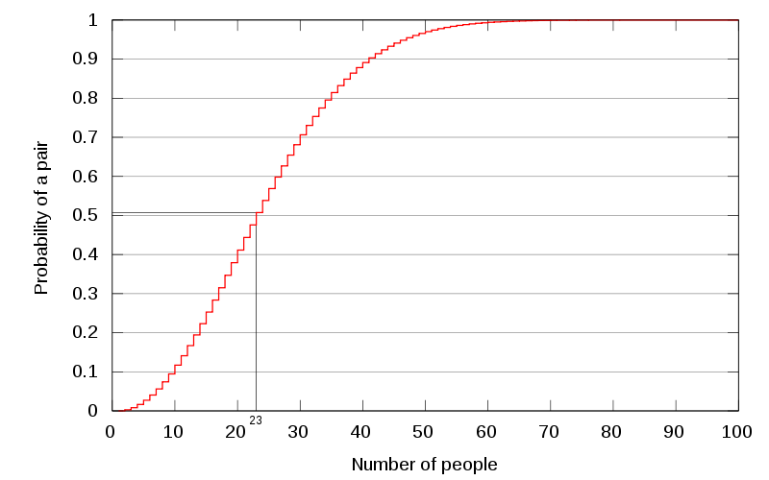
实际应用
Birthday Paradox (from Wikipedia)

Slide 10
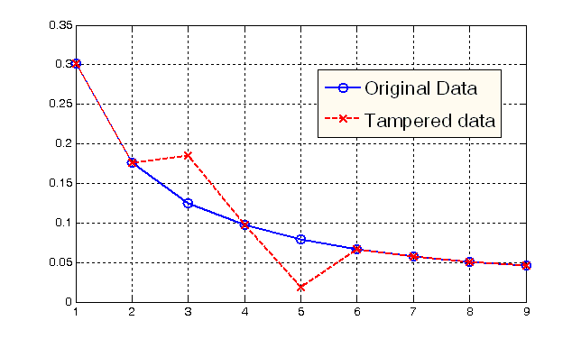
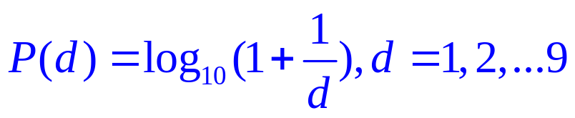
实际应用
Benford’s Law/ First Digit Law (from Wikipedia)
Accounting Forensics
Multimedia Forensics
…

Slide 11
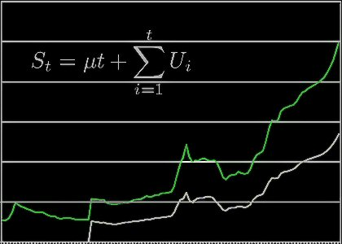
实际应用
Time Series Analysis
Economic Forecasting
Sales Forecasting
Budgetary Analysis
Stock Market Analysis
Process and Quality Control
Inventory Studies
etc.

Slide 12

实际应用
More interesting applications in real life
Millon 2 one (概率知多少):
https://www.youtube.com/watch?v=3RngSBNw1AE

Slide 13
第一章:概率论的基本概念
随机实验
样本空间、随机事件
频率与概率
等可能概型（古典概型）
条件概率
独立性

Slide 14
1. 随机实验
随机实验：
可以在相同的条件下重复地进行；
每次实验的结果不止一个，并且能事先明确实验的所有可能结果；
进行一次实验之前不能确定哪一个结果会出现
e.g.
E1: 抛一枚硬币三次，观察正面H、反面T出现的情况；
E2: 在某一批灯泡任选一只，测试其使用寿命；
E3: 记录某地昼夜最高与最低温度

Slide 15
2. 样本空间、随机事件
样本空间
随机实验E的所有可能结果组成的集合称为E的样本空间
E1: 抛一枚硬币三次，观察正面H、反面T出现的情况；
S1：{HHH、HHT、HTH、THH、HTT、THT、TTH、TTT}
E2: 在某一批灯泡任选一只，测试其使用寿命；
S2: {t | t≥0}
E3: 记录某地昼夜最高与最低温度
S3: {(x, y) | T₀ ≤x ≤ y ≤ T₁ }
集合元素类型：数字型、非数字型；
集合元素个数：有限、无穷（可数无穷、非可数无穷）
样本点
样本点即是样本空间的元素 （即集合元素）

Slide 16
2. 样本空间、随机事件
随机事件
实验E的样本空间S的子集为E的随机事件，简称事件
基本事件： 由一个样本点组成的集合
必然事件 S： 包含样本空间集合所有样本点
不可能事件 Φ：空集（不包含样本空间的任何样本点）
事件发生
在每次实验中，当且仅当这一子集中的一个样本点出现时，称这一事件发生

Slide 17
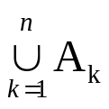

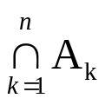

2. 样本空间、随机事件
设实验E的样本空间为S，而A、B、A_{k} (k=1,2…)是S的子集
包含关系：若A⸦B, 则事件B包含事件A，这意味着事件A发生必然导致事件B发生；若 A⸦B & B⸦A，则 A = B
和事件：事件A∪ B = {x| x∈A 或 x∈ B}
类似地，有限/可数无穷多个事件之和
积事件： 事件A ∩ B = {x| x∈A且 x∈ B}
类似地，有限/可数无穷多个事件之积

Slide 18

2. 样本空间、随机事件
差事件： 事件A - B = {x| x∈A且 x ∉ B}
事件互斥 （互不相容）： A ∩ B = Φ
逆事件 （对立事件） ： A ∩ B = Φ 且 A∪ B = S ；
事件A、B 中必有一个发生，且仅有一个发生。
A的对立事件记为

Slide 19


2. 样本空间、随机事件
Venn Diagrams
S
S
S
A
B
A
A
B
A∩B
S
全集: 样本空间 (S)
事件: 子集 (A, B…)
A
B
Disjoint events

Slide 20


2. 样本空间、随机事件
交换律： A∪ B = B∪A ; A ∩ B = B ∩ A
结合律： A∪ (B ∪C) = (A∪ B) ∪C
A ∩ (B ∩ C) = (A ∩ B) ∩ C
分配律： A∪ (B ∩ C) = (A∪ B) ∩ (A∪ C)
A ∩ (B ∪ C) = (A ∩ B) ∪ (A ∩ C)
德摩根律：

Slide 21
3. 频率与概率
频率
在相同的条件下，进行了n次实验，在这n次实验中，事件A发生的次数n_{A}称为事件A发生的频数，比值 n_{A}/n称为事件A发生的频率，记为f_{n}(A) ，可知
0≤ f_{n}(A) ≤1；
f_{n}(S) =1
若 A₁ A₂ … A_{k} 是两两互不相容事件，则
f_{n}(A₁ ∪ A₂ … ∪ A_{k} ) = f_{n} (A₁)+f_{n} (A₂)… +f_{n} (A_{k})

Slide 22
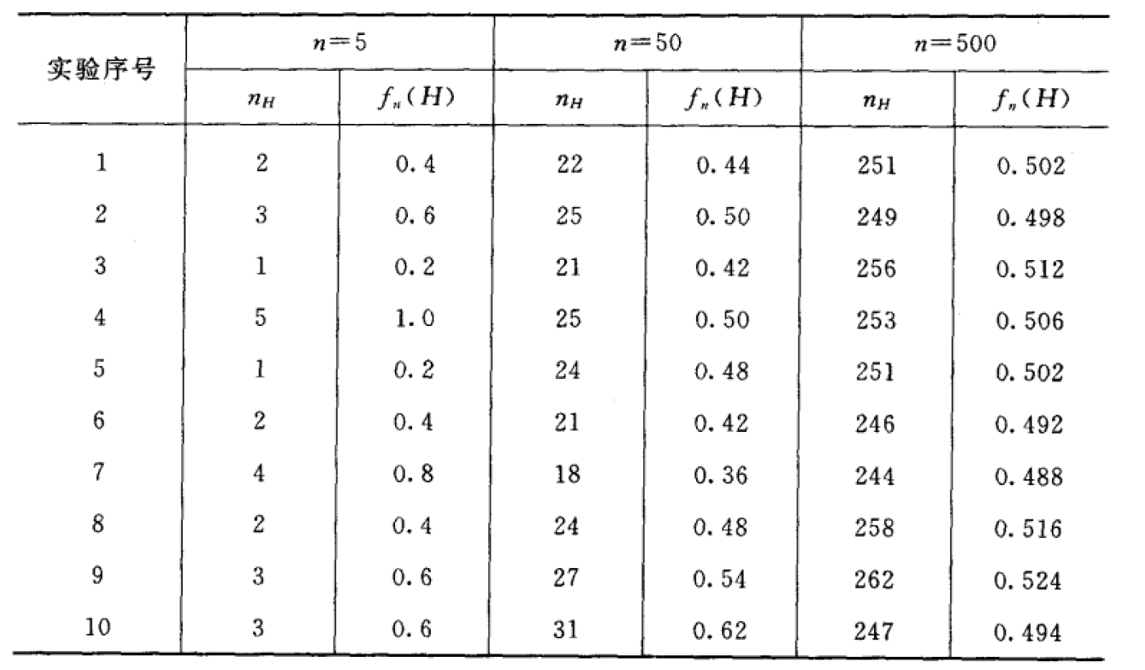
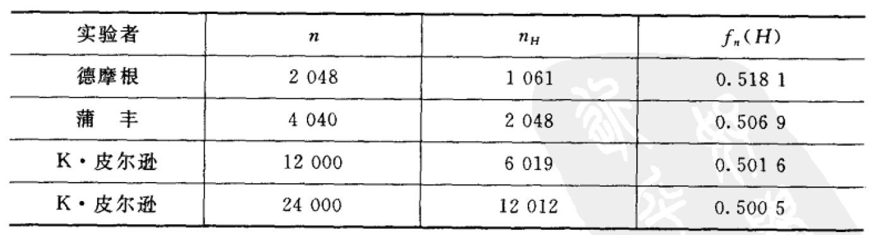
3. 频率与概率
例1. 抛硬币 (Fair)
实验结果发现：当n比较小时，频率变化幅度比较大；随着n变大，频率逐渐稳定在0.5附近

Slide 23
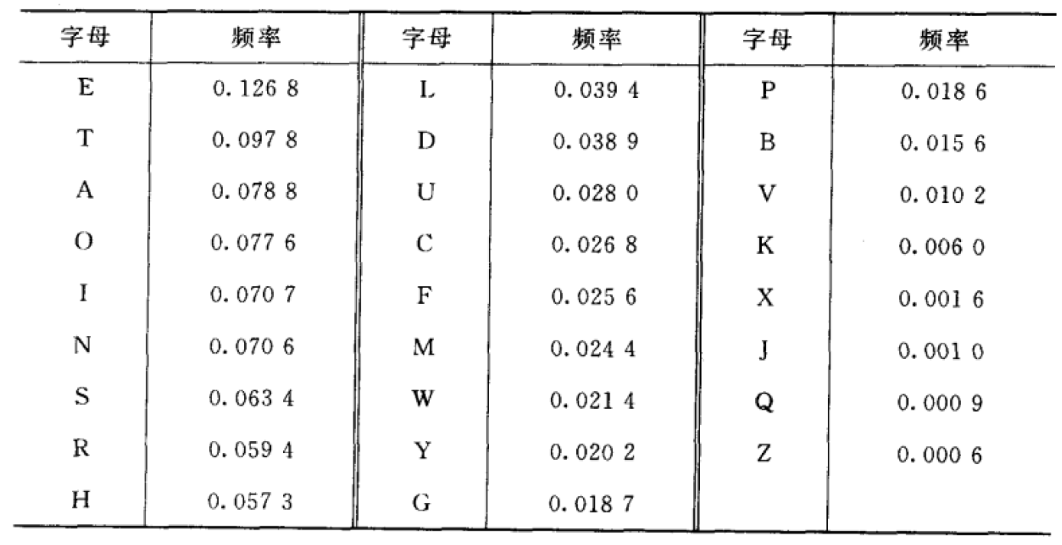
3. 频率与概率
例2. 字母使用频率
大量实验证实：
当重复实验的次数n逐渐增大时，频率f_{n}(A)呈现出稳定性，会逐渐稳定于某一个常数（大数定律保证），这个“常数”即可表示事件A发生可能性大小（即概率）。

Slide 24
3. 频率与概率
概率 （公理）
设E是随机实验，S是样本空间，对于E的每一个事件A赋予一个实数，记为P(A), 称为该事件A的概率。则集合函数P (▪) 将同时满足以下三个条件：
非负性：For all A, P(A)≥0
规范性：P(S) =1
可列可加性：设A₁ A₂ … 是两两互不相容事件
P(A₁ ∪ A₂ … ) = P(A₁)+P(A₂)+…

Slide 25
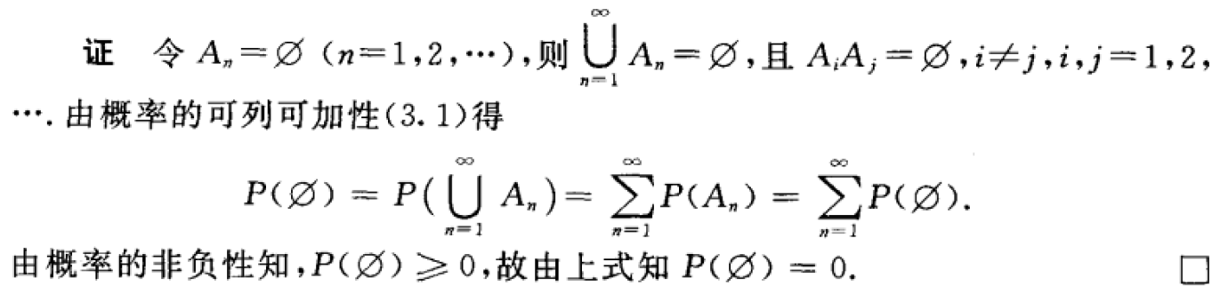
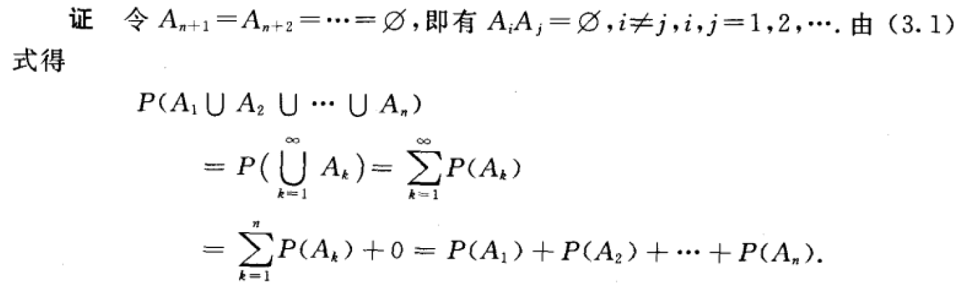
3. 频率与概率
性质1： P(Φ) =0
性质2 ：设A₁ A₂ …A_{n} 是两两互不相容事件 (有限可加性)
P(A₁ ∪ A₂ … ∪ A_{n}) = P(A₁)+P(A₂)+… P(A_{n})

Slide 26
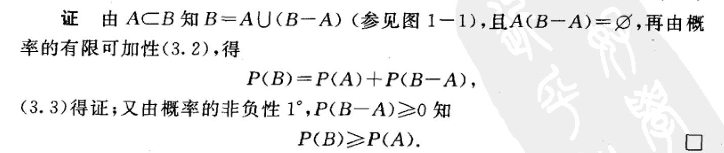
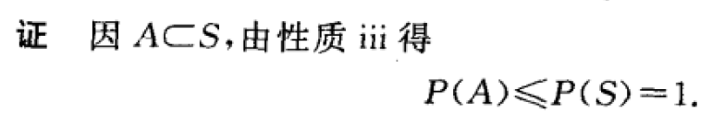
3. 频率与概率
性质3： 设A，B是两个事件，若 A⸦B，则有
P(B-A) = P(B) – P(A) ; P(B) ≥ P(A)
性质4: 对任一事件A，P(A) ≤ 1

Slide 27

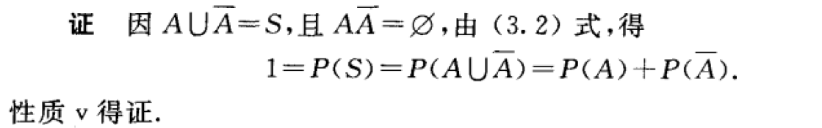
3. 频率与概率
性质5: 对任一事件A，

Slide 28


3. 频率与概率
性质6: 对任两事件A、B，有 P(A∪B) = P(A) +P(B) – P(A ∩ B)
=
+
A
B
A
B
B
A
A
A
Note: B= (B ∩ A’ ) ∪ (A ∩ B)
& (B ∩ A’ ) ∩ (A ∩ B) =ф
Proof:
P(A ∪ B) = P(A) + P(B ∩ A’)
= P(A) + [P(B) – P(A ∩B)]

Slide 29
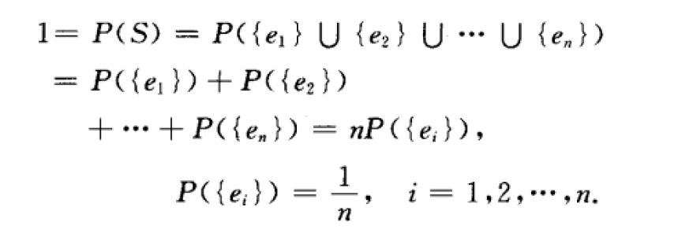
4. 等可能概型（古典概型）
古典概型
实验的样本空间只包含有限个元素；
实验中每个基本事件发生的可能性相同
设实验样本空间为S={e₁,e₂,…e_{n}}. 由古典概型条件可知,
P({e₁})= P({e₂}) … =P({e_{n}})
e_{i} ∩ e_{j} = Φ, i≠j

Slide 30
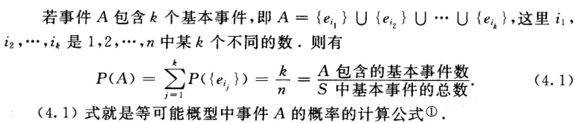
4. 等可能概型（古典概型）
对任何事件A,
因此，古典概型概率的计算转换为一个基本事件的“数数”问题！

Slide 31
4. 等可能概型（古典概型）
乘法原理 (核心：分步)
组合数 与 排列数

Slide 32
4. 等可能概型（古典概型）
Ordered Pair
By an ordered pair, we mean that, if O₁ and O₂ are different objects, then the pair (O₁,O₂) is different from the pair (O₂,O₁).
Counting the number of ordered pair
If the first element of object of an ordered pair can be selected in n₁ ways, and for each of these n₁ ways the second element of the pair can be selected in n₂ ways, then the number of pairs is n₁n₂

Slide 33
4. 等可能概型（古典概型）
Example
A homeowner doing some remodeling requires the services of both a plumbing contractor and an electrical contractor. If there are 12 plumbing contractor P₁, P₂, …P₁₂ and 9 electrical contractors Q₁, Q₂, …, Q₉ available in the area, in how many ways can the contractors be chosen?
Task: counting the number of pairs of the form (P_{i}, Q_{j})
With n₁= 12, n₂=9, the produce rule yields N = 12×9=108
Note: In this example, the choice of the second element of the pair did not depend on which first element was chosen or occurred.

Slide 34
4. 等可能概型（古典概型）
Example
A family has just moved to a new city and requires the services of both an obstetrician and a pediatrician. There are two easily accessible medical clinics, each having 2 obstetricians and 3 pediatricians. The family will obtain maximum health insurance benefits by joining a clinic and selecting both doctors from that clinic. In how many ways can this be done?
Denote the obstetricians by O₁,O₂,O₃, and O₄ and the pediatricians by P₁,…,P₆. Then we wish the number of pairs (O_{i}, P_{j}) for which O_{i} and P_{j} are associated with the same clinic. Because there are four obstetricians, n₁=4, and for each there are three choices of pediatrician, so n₂=3. Applying the product rule gives N= n₁ n₂=12 possible choices.

Slide 35
4. 等可能概型（古典概型）
Tree Diagrams (树图)
P₁
P₂
P₃
O₁
Note: The construction of a tree diagram
does not depend on having the same
number of Second-generation braches
emanating from each First-generation
branch.
Thus a tree diagram can be used
to represent pictorially experiments other
than those to which the product rule
applies.
P₁
P₂
O₂
P₃
O₃
P₄
P₅
O₄
P₆
P₄
P₅
P₆

Slide 36
4. 等可能概型（古典概型）
K-tuple
An ordered collection of k objects
Product Rule for k-Tuple
Support a set consists of ordered collections of k elements (k-tuples) and that there are n₁ possible choices for the first element; for each choice of the first element, there are n₂ possible choices of the second element; …, for each possible choice of the first k-1 elements, there are n_{k} choices of the k-th element. Then there are n₁n₂…n_{k} possible k-tuples.

Slide 37
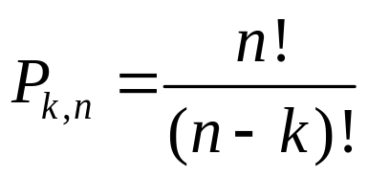
4. 等可能概型（古典概型）
Permutation (排列数)
Any ordered sequence of k objects taken from a set of n distinct objects is called a permutation of size k of the objects. The number of permutations of size k that can be constructed from the n objects is denoted by P_{k,n}.
P_{k,n} = n (n-1) (n-2) … (n-k+1)

Slide 38
4. 等可能概型（古典概型）
Example
There are 10 teaching assistants available for grading papers in a particular course. The first exam consists of 4 questions, and the professor wishes to select a different assistant to grade each question (only one assistant per question). In how many ways can assistants be chosen to grade the exam?
Here
n = the number of assistants=10 &
k = the number of questions =4.
The number of different grading assignments is then
P_{k,n}=10×9×8×7=5040

Slide 39
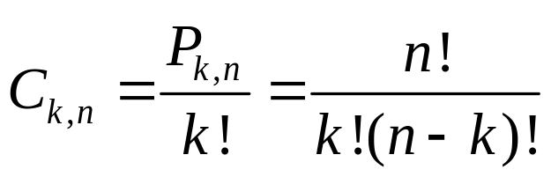
4. 等可能概型（古典概型）
Combinations （组合数）
Given a set of n distinct objects, any unordered subset of size k of the objects is called a combination. The number of combinations of size k that can be formed from the n distinct objects will be denoted by C_{k,n}
Note: the number of combinations of size k from a particular set is
smaller than the number of permutations because, when order is
disregarded, a number of permutations correspond to the same combination.

Slide 40
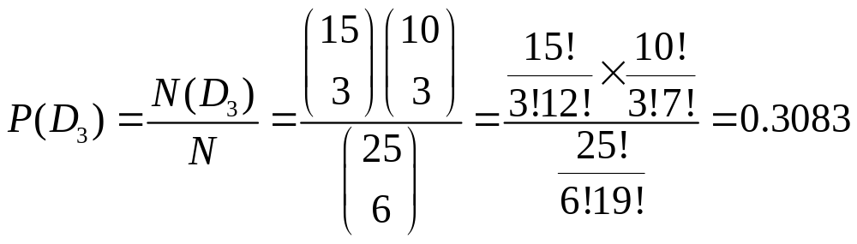
4. 等可能概型（古典概型）
Example
A university warehouse has received a shipment of 25 printers, of which 10 are laser printer and 15 are inkjet models. If 6 of these 25 are selected at random to be checked by a particular technician, what is the probability that exactly 3 of those selected are laser printers?
Let D₃ ={exactly 3 of the 6 selected are inkjet printers}

Slide 41
4. 等可能概型（古典概型）
例2. 一个口袋有4白球，2红球。从袋子取两球，每次随机取一只，考虑2种取法：
1) 每次取完后放回 (放回抽样)
2) 每次取完后不放回 （不放回抽样）
Q1： 取到的两个球都是白球的概率？
Q2： 取到的两个球颜色相同的概率？
Q3： 取到的两个球至少有一只是白球的概率？

Slide 42
4. 等可能概型（古典概型）
Case : 放回抽样
4/6
WW 4/9
W
Q1: P(WW) = 4/9
4/6
W
R
2/6
WR 2/9
Q2: P(WW) + P(RR) = 5/9
W
4/6
RW 2/9
R
2/6
Q3: P(WW)+P(WR) + P(RW) = 1- P(RR)
= 8/9
R
2/6
RR 1/9

Slide 43
4. 等可能概型（古典概型）
Case : 不放回抽样
3/5
WW 2/5
W
Q1: P(WW) = 2/5
4/6
W
R
2/5
WR 4/15
Q2: P(WW) + P(RR) = 7/15
W
4/5
RW 8/15
R
2/6
Q3: P(WW)+P(WR) + P(RW) = 1- P(RR)
= 14/15
R
1/5
RR 1/15

Slide 44
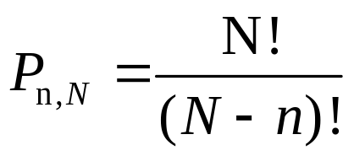
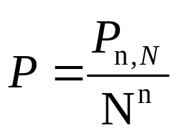
4. 等可能概型（古典概型）
例3. 将n只球随机地放入N (N≥n) 个盒子，试求每个盒子至多有一个球的概率
将n只球随机放入N个盒子的可能个数(乘法原理)： N^{n}
将n只球不重复放入N个盒子的可能个数：
所求概率大小：

Slide 45
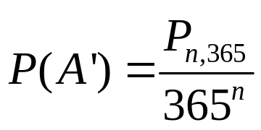
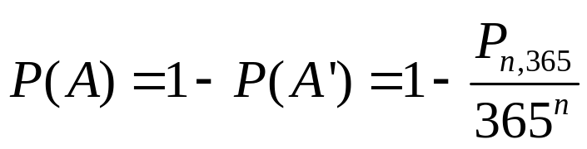
4. 等可能概型（古典概型）
Birthday Paradox
In a set of n randomly chosen people (n is less than 366), what is the probability that some pair of them having the same birthday?
Let A={at least one pair of the n people having the same birthday}.
Then A’ = {all the n people have different birthday}.
n | 10 | 20 | 23 | 30 | 40 | 50
P(A) | 0.12 | 0.41 | 0.51 | 0.71 | 0.89 | 0.97

Slide 46
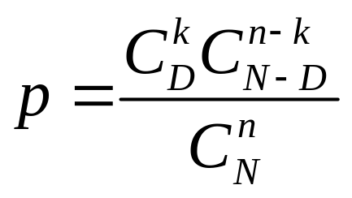
4. 等可能概型（古典概型）
例4 设N件产品中含D件次品，今从中任意取n件(不放回情形)，问其中恰有k (k≤D)件次品的概率是多少
超几何分布

Slide 47
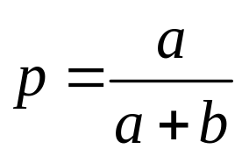
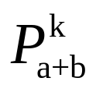
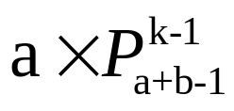
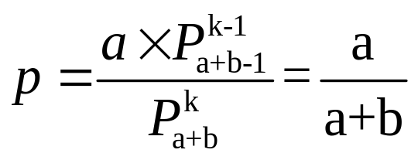
4. 等可能概型（古典概型）
例5. 袋中有a只白球，b只红球，k个人依次在袋中取一只球 ，求第i (i=1,2,…k) 人取到白球(记为事件B)的概率 k≤a+b
Case#1：放回抽样
Case#2：不放回抽样
样本空间基本事件个数：
第i个人取到白球包含的基本事件个数：

Slide 48
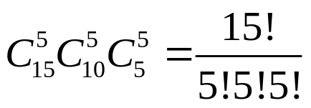
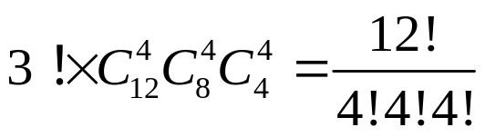
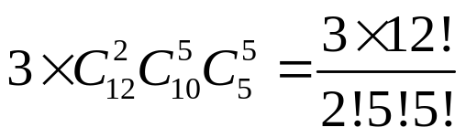
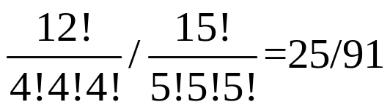
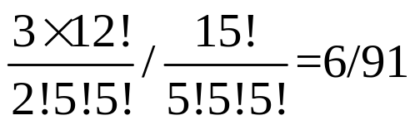
4. 等可能概型（古典概型）
例7. 将15名新生随机地平均分配到三个班级中去，这15名新生中有3名是优秀生，求
Q1. 每个班级各分配到一名优秀生的概率是多少；
Q2. 三名优秀生分配在同一班级的概率是多少
15名新生平均分配到三个班级的分法总数：
三个班各有一名优秀生分法总数：
三名优秀毕业生分配到同一班的总数：
Q1:
Q2:

Slide 49
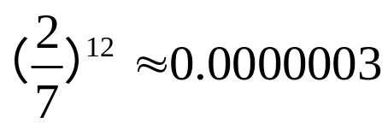
4. 等可能概型（古典概型）
例8 某接待站在某一周曾经接待12次来访，已知所有这12次接待都是在周二和周四进行，问是否可以推断接待时间是有规定的？
解：若接待时间没有规定，而各来访者在一周内任一天中去接待站是等可能的，那么12次接待都在周二和周四的概率大小为
概率很小的事件在一次实验中实际上几乎是不发生的（实际推断原理）

Slide 50
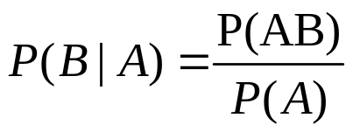
5. 条件概率
定义. 设A、B是两个事件，且P(A)>0
为在事件A发生的条件下事件B发生的条件概率
S
Note:
1. Given that A has occurred, the relevant
sample space is no longer S but consists
of outcomes in A;
2. B has occurred if and only if one of the
outcomes in the intersection occurred.
A
B
注：条件概率同样满足非负性、规范性及可列可加性

Slide 51
5. 条件概率
Example 2.24
Complex components are assembled in a plant that uses two different assembly lines, A and A’. Line A uses older equipment than A’, so it is somewhat slower and less reliable. Suppose on a given day line A has assembled 8 components, of which 2 have been identified as defective (B) and 6 as nondefective (B’), whereas A’ has produced 1 defective and 9 nondefective components. This information is summarized in the accompanying table.
 |  | Condition
 |  | B | B’
Line | A | 2 | 6
 | A’ | 1 | 9

Slide 52
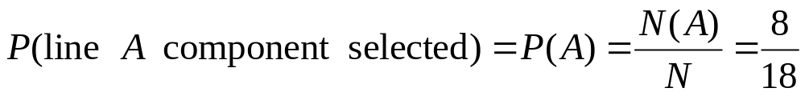
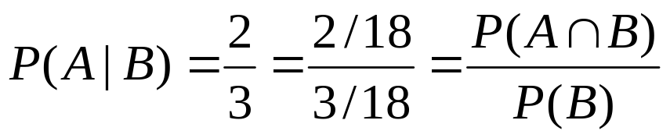
5. 条件概率
 |  | Condition
 |  | B | B’
Line | A | 2 | 6
 | A’ | 1 | 9
The sales manager randomly selects 1 of these 18 components for a demonstration. Prior to the demonstration
However, if the chosen component turns out to be defective, then the event B has occurred, so the component must have been 1 of the 3 in the B column of the table. Since these 3 components are equally likely among themselves after B has occurred,

Slide 53
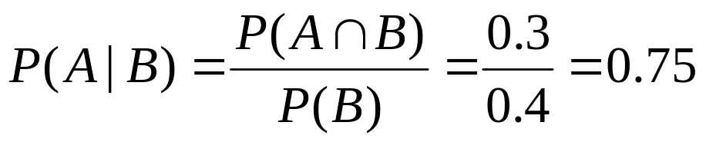
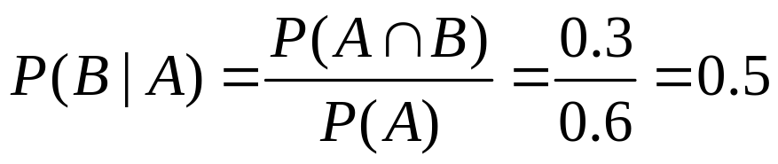

5. 条件概率
Example 2.25
Consider randomly selecting a buyer and let A={memory card purchased} and B={battery purchased}. Then P(A)=0.6, P(B)=0.4 and P(both purchased) = P(A∩B) = 0.3. Given that the selected individual purchased an extra battery, the probability that an optional card was also purchased is
That is, of all those purchasing an extra battery, 75% purchased an optional memory card. Similarly,

Slide 54
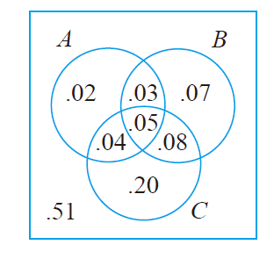
5. 条件概率
Example 2.26
A news magazine publishes three columns entitled “Art”(A), “Books”(B), and “Cinema”(C). Reading habits of a randomly selected reader with respect to these columns are
Read regularly | A | B | C | A∩B | A∩C | B∩C | A∩B∩C
Probability | 0.14 | 0.23 | 0.37 | 0.08 | 0.09 | 0.13 | 0.05
P(A|B) =0.348
P(A|B ∪C) =0.255
P(A|A ∪B∪C) =0.286
P(A ∪B|C) =0.459

Slide 55
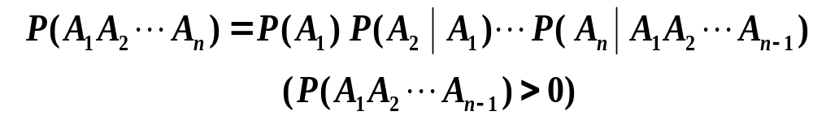
5. 条件概率
乘法定理 设P(A)>0, 则有
P(AB) = P(B|A)P(A)
该定理可推广到多个事件情况
P(ABC) = P(C|AB)P(B|A) P(A) , P(AB) >0

Slide 56

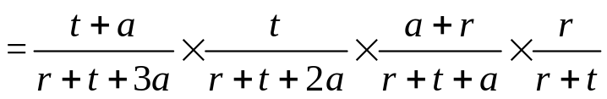
5. 条件概率
例3 设袋中装有r只红球，t只白球，每次自袋中任取一只球，观察其颜色然后放回，并再放入a只与所取颜色相同的球，若在袋中连续取球四次，试求第1、2次取到红球且第3，4次取到白球的概率
解 以A_{i} (i=1,2,3,4) 表示事件第i次取到红球, 则所求概率事件为

Slide 57
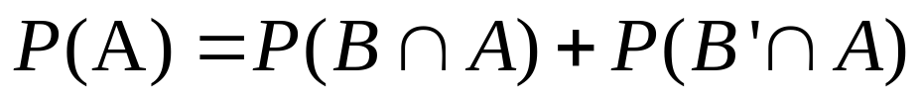
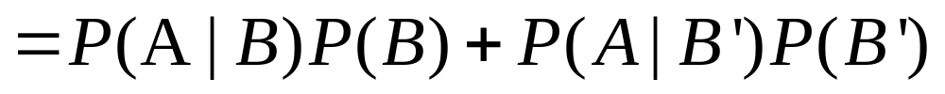
5. 条件概率
The Law of Total Probability (2-D Case)
B
B’
Note:
B U B’ =S
B ∩ B’ = ф
A
A ∩ B
A ∩ B’
S

Slide 58
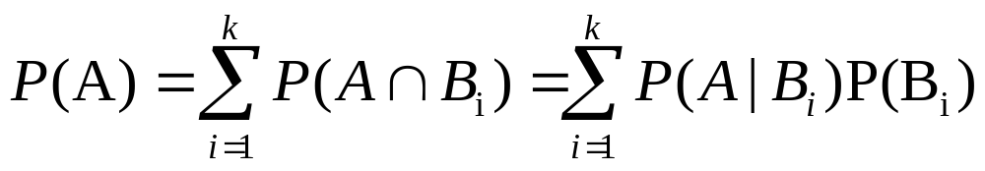
5. 条件概率
The Law of Total Probability (全概率公式)
Let B₁, …B_{n} be mutually exclusive and exhaustive events (Partition of S). Then for any other event A
B₂
B_{n}
B₁
A
…
S
B₃
B₄

Slide 59
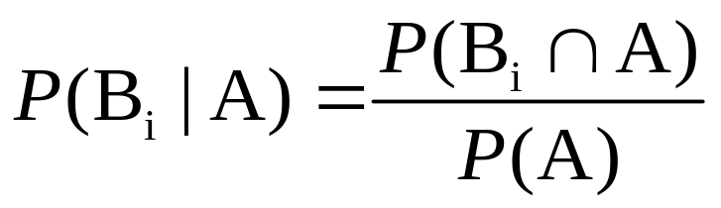
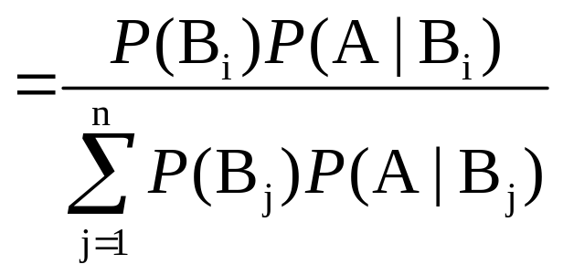

5. 条件概率
Bayes’ Theorem
Let B₁,B₂,…B_{n} be a collection of n multually exclusive and exhaustive events with P(B_{i})>0 for i=1,…n, then for any other event A for which P(A)>0.

Slide 60


5. 条件概率
例6 据美国一份资料报道，在美国总的来说患肺癌的概率约为0.1%,在人群中有20%是吸烟者，他们患肺癌的概率约为0.4%，求不吸烟者患肺癌的概率是多少？
解：设C为事件“患肺癌”，A为事件“吸烟”，则由题意得 P(C) = 0.1%, P(A) = 0.2, P(C|A) = 0.4%， 则

Slide 61
5. 条件概率
Example 2.31
Incidence of a rare disease. Only 1 in 1000 adults is afflicted with a rare disease for which a diagnostic test has been developed. The test is such that when an individual actually has the disease, a positive result will occur 99% of the time, whereas an individual without the disease will show a positive test result only 2% of the time. If a randomly selected individual is tested and the result is positive, what is the probability that the individual has the disease?
Let: A₁={individual has the disease} A₂={individual does not have the disease}, and B ={positive test result}. Then P(A₁)=0.001; P(A₂)=0.999, P(B|A₁)=0.99 and P(B|A₂)=0.02.

Slide 62




5. 条件概率
Example 2.31 Cont’
0.99
B=+Test
0.001
0.01
A1=has disease
B=-Test
0.999
0.02
B=+Test
A2=doesn’t have disease
0.98
B=-Test
P(B) = P(A₁∩B) + P(A₂∩B) =0.2097

Slide 63

5. 条件概率
例8. 以往数据分析表明，当机器调整得良好时，产品的合格率为98%，而当机器发生某种故障时，合格率为55%，每天早上机器开动时，机器调整良好的概率为95%，试求已知某日早上第一件产品是合格品，机器调整良好的概率为多少？
设A为事件“产品合格”，B为事件“机器调整良好”。则
题目需要求
P(B)=0.95是根据以往数据分析得到，看作是先验概率；
在得到信息（即生产出的第一件产品为合格品）之后在修正的概率(0.97)称为后验概率

Slide 64
6. 独立性
定义 设A、B两个事件，如果满足等式
P(AB) = P(A)P(B)
Note: 若P(A)>0, P(B)>0, 则A、B相互独立与A、B互不相容不能同时成立。
定理1. 设A、B是两事件，且P(A)>0。若A、B相互独立，则
P(B|A)=P(B),反之亦然。
定理2. 若事件A与事件B相互独立，则
a. A’ and B b. A and B’ c. A’ and B’
也相互独立

Slide 65

6. 独立性
Mutually Independent
Events A₁, A₂, …A_{n} are mutually independent if for every k (k=2,3…n) and every subset of indices i₁,i₂…i_{k}
P(A_{i1} ∩A_{i2}… ∩Ai_{k}) = P(A_{i1})P(A_{i2})…P(A_{ik})
需要验证：
等式

Slide 66


6. 独立性
例2 如图所示，系统由四个独立工作的元件组成，设第i个原件的可靠性为p_{i},(i=1,2,3,4)试求该系统的可靠性。
假设各元件相互独立

Slide 67


6. 独立性
例4 甲乙两人进行乒乓球比赛，每局甲胜的概率为p (p≥1/2). 问对甲而言，采取三局两胜制有利，还是五局三胜制有利，设各局胜负相互独立
三局两胜，甲获胜的情况有：甲甲，乙甲甲 或 甲乙甲
类似地分析五局三胜，情况

Slide 68
Homeworks
Ex. 1, 3, 4, 8, 13, 22, 24, 26, 29, 31, 32, 37

